Slide 1


奥托立夫供应商行为准则
More Lives Saved
More Life Lived
生效日期：2023 年 1 月 1 日
Notes:
Chinese ALL
欢迎参加有关奥托立夫供应商行为准则的培训。 在本培训中，对奥托立夫供应商行为准则、供应商行为准则和“准则”的引用均意指同一事物。

Slide 2
Script: Slide 1
ENGLISH | Chinese
Welcome to this training on the Autoliv Supplier Code of Conduct. Throughout this training references to Autoliv Supplier Code of Conduct, Supplier Code of Conduct, and ‘The Code’ are all intended to mean the same thing. | 欢迎参加有关奥托立夫供应商行为准则的培训。 在本培训中，对奥托立夫供应商行为准则、供应商行为准则和“准则”的引用均意指同一事物。

Slide 3
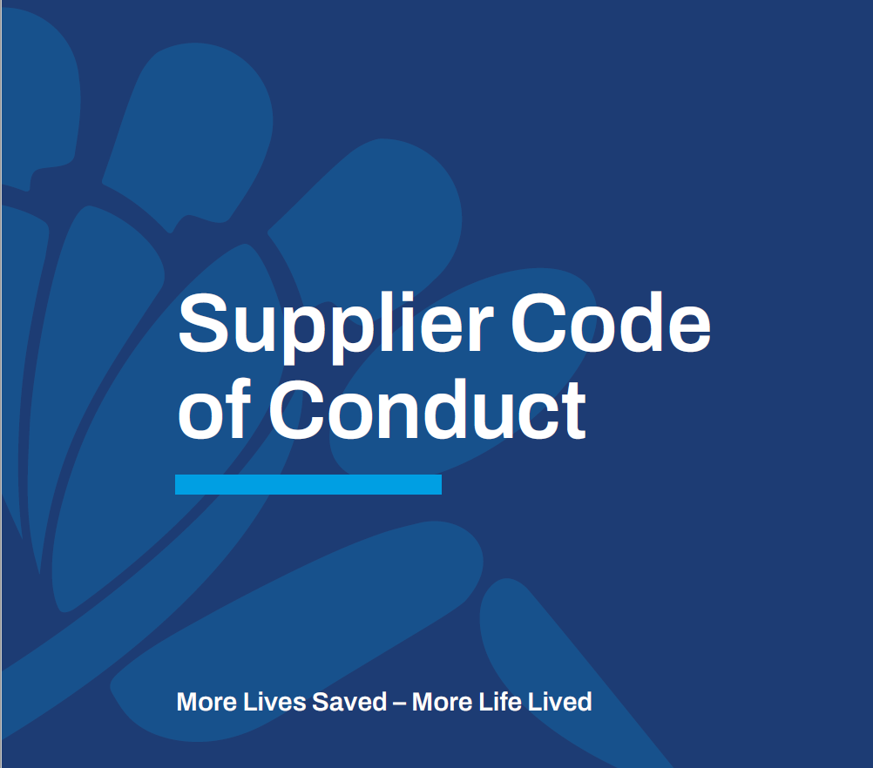
为什么我们的供应商行为准则如此重要？
我们所有主要利益相关者对我们如何经营可持续业务的期望越来越高
我们的供应商在所有权结构和业务运营方面的透明度很重要，因为我们想知道我们与谁做生意
通过努力收集和审查信息，我们可以管理和减轻法律、道德、声誉和社会风险
如果不主动管理此类风险，可能会破坏和损害我们的声誉、客户信心、员工信任和忠诚度
Notes:
Chinese
在当今不断发展的世界中，争论是否将透明度和完整性纳入您的业务战略已不再是一种选择。 对于公司来说，解决在任何情况下知道什么是正确的事情和做正确的事情之间的差距变得更加重要。 如果这很难判断并且需要一些指导，请提出问题。 在奥托立夫，我们拥护全球公认的原则和价值观，我们将其纳入我们自己的奥托立夫行为准则和奥托立夫供应商行为准则。对我们来说，重要的是我们知道我们在与谁做生意。 我们希望确保我们的伙伴关系和协作建立在共同商定的开展业务的标准之上。 我们不仅为我们自己的员工，也为我们可能从事业务的任何其他人制定了雄心勃勃的标准。

Slide 4
Script: Slide 2
ENGLISH | Chinese
In today’s ever-evolving world, debating whether to incorporate transparency & integrity into your business strategy is no longer an option. It is becoming even more critical for companies to address the gap between knowing what is the right thing to do and doing the right thing in every instance. And to Speak Up, ask questions if this is hard to judge and some guidance is needed. At Autoliv, we are embracing globally established principles & values which we incorporate into our own Autoliv Code of Conduct & the Autoliv Supplier Code of Conduct. For us, it is important that we know who we are doing business with. We want to make sure that our partnerships and collaborations are built on mutually agreed upon standards of conducting business. We have set ambitious standards not only for our own employees, but also for anyone else who we might engage in business. | 在当今不断发展的世界中，争论是否将透明度和诚信纳入您的业务战略已不再是一种选择。 对于公司来说，解决在任何情况下知道什么是正确的事情和做正确的事情之间的差距变得更加重要。 如果这很难判断并且需要一些指导，请提出问题。 在奥托立夫，我们拥护全球公认的原则和价值观，我们将其纳入我们自己的奥托立夫行为准则和奥托立夫供应商行为准则。 对我们来说，重要的是我们知道我们在与谁做生意。我们希望确保我们的伙伴关系和协作建立在共同商定的开展业务的标准之上。 我们不仅为我们自己的员工，也为我们可能从事业务的任何其他人制定了雄心勃勃的标准。

Slide 5


可持续发展深深植根于奥托立夫的商业战略
作为一家坚定致力于可持续商业实践的全球领先公司，我们对我们的业务、员工和业务合作伙伴制定了高标准的行为准则
我们的准则以清晰的语言阐明了我们承诺遵守的道德和法律标准
我们准则中规定的标准已融入我们的气候与可持续发展目标，并与全球领先实体保持一致。
Notes:
Chinese
Autoliv’s vision of Saving More Lives, drives all our work. Sustainability is firmly rooted in our business strategy and as a market leader in our field, our efforts are aligned with the broader society’s agenda. To lead the way and being an active contributor to sustainable mobility and society is a business priority for us. It strengthens our market-leadership and competitive edge.
Through our Supplier Code of Conduct, we want to ensure that we are engaging with global stakeholders that understand that sustainable business and great business must incorporate environmental, social, & ethical standards; where profits are not obtained at the expense of or detriment to people or the planet.
The standards set out in our code are integrated into our Climate & Sustainability ambitions and aligned with:
The United Nations Global Compact
The United Nations Universal Declaration of Human Rights
International Labour Organisation’s Declaration on Fundamental Principles & Rights at Work
OECD Guidelines for Multinational Enterprises
The Global Automotive Sustainability Guiding Principles
In order to conduct business with Autoliv, our suppliers must commit to the Autoliv Supplier Code of Conduct. To ensure that we do not have any ‘bad actors’ in the Autoliv value chain, Suppliers must also commit to mandating these same set of principles to each entity they transact business with.
It is inherently important that we can ensure the highest standards of sustainability and ethical behavior within our value chain.

Slide 6
Script: Slide 3
ENGLISH | Chinese
Autoliv’s vision of Saving More Lives, drives all our work. Sustainability is firmly rooted in our business strategy and as a market leader in our field, our efforts are aligned with the broader society’s agenda. To lead the way and being an active contributor to sustainable mobility and society is a business priority for us. It strengthens our market-leadership and competitive edge. Through our Supplier Code of Conduct, we want to ensure that we are engaging with global stakeholders that understand that sustainable business and great business must incorporate environmental, social, & ethical standards; where profits are not obtained at the expense of or detriment to people or the planet. The standards set out in our code are integrated into our Climate & Sustainability ambitions and aligned with: The United Nations Global Compact The United Nations Universal Declaration of Human Rights International Labour Organisation’s Declaration on Fundamental Principles & Rights at Work OECD Guidelines for Multinational Enterprises The Global Automotive Sustainability Guiding Principles In order to conduct business with Autoliv, our suppliers must commit to the Autoliv Supplier Code of Conduct. To ensure that we do not have any ‘bad actors’ in the Autoliv value chain, Suppliers must also commit to mandating these same set of principles to each entity they transact business with. It is inherently important that we can ensure the highest standards of sustainability and ethical behavior within our value chain. | 奥托立夫拯救更多生命的愿景推动着我们所有的工作。 可持续发展牢牢植根于我们的业务战略，作为我们领域的市场领导者，我们的努力与更广泛的社会议程保持一致。 引领潮流并为可持续交通和社会做出积极贡献是我们的业务重点。 它加强了我们的市场领导地位和竞争优势。 通过我们的供应商行为准则，我们希望确保我们与全球利益相关者合作，这些利益相关者了解可持续发展的企业和伟大的企业必须纳入环境、社会和道德标准； 利润不是以牺牲或损害人类或地球为代价获得的。 我们准则中规定的标准已融入我们的气候与可持续发展目标，并符合： 联合国全球契约 联合国世界人权宣言 国际劳工组织关于工作中基本原则和权利的宣言 经合组织跨国企业指南 全球汽车可持续发展指导原则 为了与奥托立夫开展业务，我们的供应商必须遵守奥托立夫供应商行为准则。 为确保我们在奥托立夫价值链中没有任何“不良行为者”，供应商还必须承诺将这些相同的一套原则强制要求与他们进行业务往来的每个实体。 我们能够确保我们的价值链中的可持续性和道德行为达到最高标准，这一点本身就很重要。

Slide 7
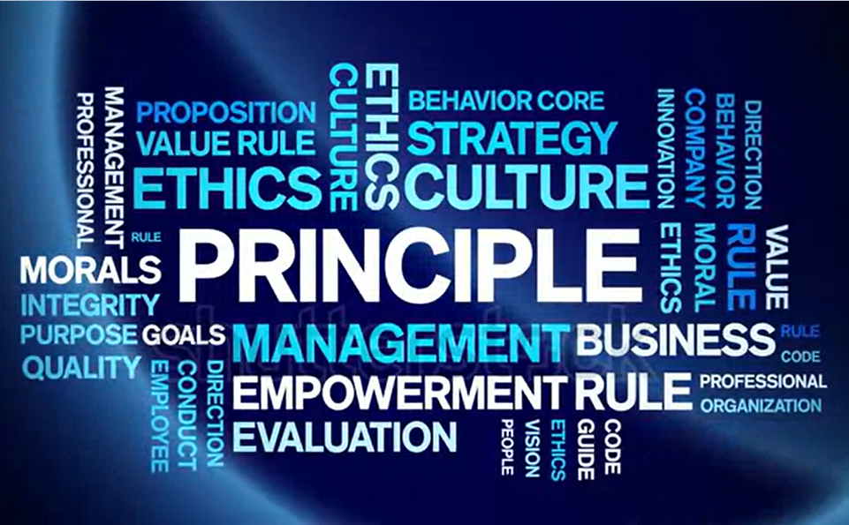
供应商行为准则的目标
定义道德和有尊严的行为对奥托立夫意味着什么
创造机会与与我们具有相同商业行为和尊严标准的企业合作
确保遵守最高标准 :
  安全的工作环境
  公平和尊重地对待员工
  道德规范
Notes:
Chinese
We have identified several goals that we would like to achieve with The Code & this training:
We want to:
Define what ethical & dignified conduct means to us here at Autoliv
Ensure that we only execute business with other entities that have the same regard for sustainable business practices as we do
Guarantee that through our work we do not exploit resources, engage in unethical business practices or be a party to human rights violations
Secure that people can work in a safe environment where they are respected and safe

Slide 8
Script: Slide 4
ENGLISH | Chinese
We have identified several goals that we would like to achieve with The Code & this training: We want to: Define what ethical & dignified conduct means to us here at Autoliv Ensure that we only execute business with other entities that have the same regard for sustainable business practices as we do Guarantee that through our work we do not exploit resources, engage in unethical business practices or be a party to human rights violations Secure that people can work in a safe environment where they are respected and safe | 我们已经确定了我们希望通过《守则》和本次培训实现的几个目标： 我们想： 定义道德和有尊严的行为对我们在奥托立夫意味着什么 确保我们只与与我们一样重视可持续商业实践的其他实体开展业务 保证我们不会通过我们的工作过度开采资源、从事不道德的商业行为或成为侵犯人权的一方 确保人们可以在安全的环境中工作，在那里他们受到尊重和安全

Slide 9
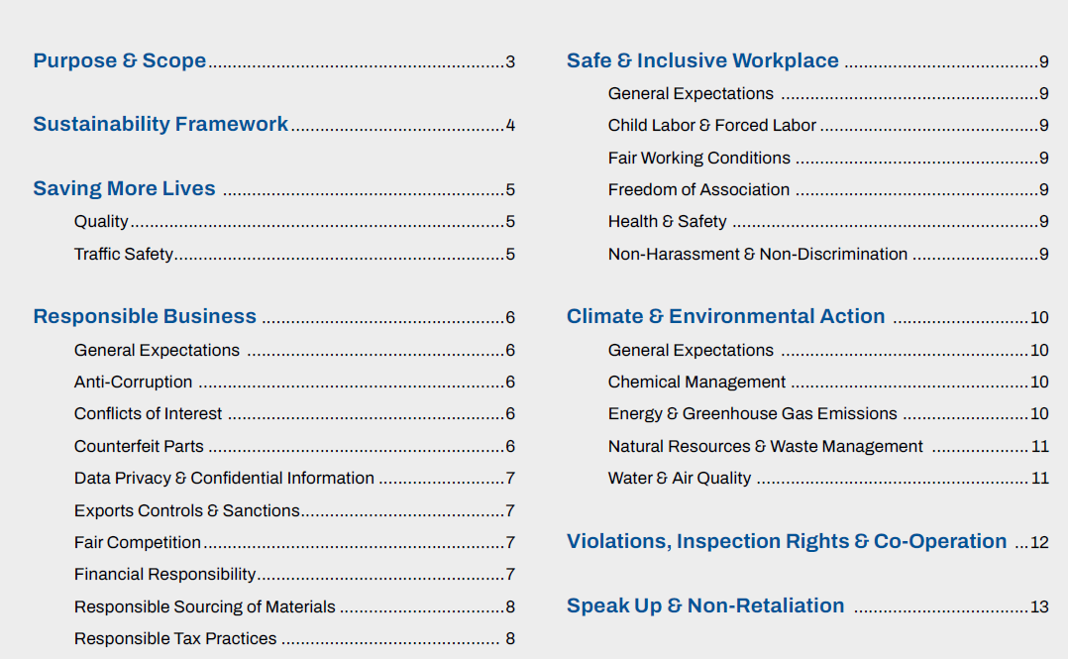
Overall Content
整体内容
我们修改了整个供应商行为准则，
有些部分是新的，需要进一步注意 :
  气候与可持续发展目标
  传递到整个奥托立夫价值链
  说出来
请提交问题至 : ALV-SCMSustainability@autoliv.com
Notes:
English Internal
We have revised our entire Supplier Code of Conduct and have added some new sections. It is important that you understand that everything within ‘The Supplier Code’ is relevant and necessary.
We recommend that each of our buyers review ‘The Supplier Code’ internally with your management teams and ask questions regarding sections you may not fully understand. Please submit questions to: ALV-SCMSustainabilit@autoliv.com

Slide 10
Script: Slide5
ENGLISH External | Chinese
We have revised our entire Supplier Code of Conduct and have added some new sections. It is important that you understand that everything within ‘The Supplier Code ’ is relevant and necessary. We recommend that each of our suppliers review ‘The Supplier Code’ internally with your management teams. This will help ensure you can identify any gaps in your own Code of Conduct that need to be revised to align with Autoliv’s Code of Conduct. You will also need to develop an internal strategy for cascading these requirements to your sub-suppliers. | 我们修订了整个供应商行为准则并添加了一些新部分。 了解“供应商准则”中的所有内容都是相关且必要的，这一点很重要。 我们建议我们的每个供应商与您的管理团队一起在内部审查“供应商准则”。 这将有助于确保您能够找出您自己的行为准则中需要修改的任何漏洞，以与奥托立夫的行为准则保持一致。 您还需要制定内部策略，将这些要求传递给您的次级供应商。

Slide 11

亮点和例子
气候与可持续发展目标
将准则传递整个价值链
冲突矿产尽职调查
Notes:
English
Climate & Sustainability Targets
You have been using the same sub-supplier for years, but when you asked them about a GHG Emissions reduction strategy or Climate targets, they indicate to you that they will not be developing any type of climate program as they don’t think climate change is real.
What would you do?
As part of Autoliv’s Supplier Code of Conduct, it is mandatory for our suppliers to have or develop climate ambitions and targets aligned with Autoliv’s Climate Strategy. This is also a requirement that is increasingly enforced by our customers. In this case, the supplier must commit to implementing a Climate Strategy included GHG Emission reduction targets and passing it on to its employees and sub-suppliers.
Cascade The Code to Entire Value Chain
You are in the process of nominating a new supplier to supply Autoliv with raw materials. The supplier is known in the market for operating in high-risk countries. During the onboarding process, he states that he does not have a Code of Conduct and does not think it is important to implement one.
What would you do?
As part of Autoliv's sustainability audits, it is mandatory for our suppliers to have or develop their own Code of Conduct. In this way, Autoliv ensures that our suppliers follow the same principles as we do. This is also a requirement that is increasingly enforced by our customers. In this case, the supplier must commit to implementing a Code of Conduct and passing it on to its employees and sub-suppliers.
Conflict Minerals Due Diligence
You have just read an article on regarding a gold smelter that has been fined for human rights violations and forced labor. You know that this smelter sources gold to you and ultimately ends up in Autoliv parts.
What would you do?
Autoliv has taken a strong stance against human rights violations and forced labor. We do not want our company linked to any business that does not fairly deal with their employees. All business transactions with these smelters should be terminated immediately.

Slide 12
Script: Slide 6
ENGLISH | Chinese
Climate & Sustainability Targets You have been using the same sub-supplier for years, but when you asked them about a GHG Emissions reduction strategy or Climate targets, they indicate to you that they will not be developing any type of climate program as they don’t think climate change is real. What would you do? As part of Autoliv’s Supplier Code of Conduct, it is mandatory for our suppliers to have or develop climate ambitions and targets aligned with Autoliv’s Climate Strategy. This is also a requirement that is increasingly enforced by our customers. In this case, the supplier must commit to implementing a Climate Strategy included GHG Emission reduction targets and passing it on to its employees and sub-suppliers. Cascade The Code to Entire Value Chain You are in the process of nominating a new supplier to supply Autoliv with raw materials. The supplier is known in the market for operating in high-risk countries. During the onboarding process, he states that he does not have a Code of Conduct and does not think it is important to implement one. What would you do? As part of Autoliv's sustainability audits, it is mandatory for our suppliers to have or develop their own Code of Conduct. In this way, Autoliv ensures that our suppliers follow the same principles as we do. This is also a requirement that is increasingly enforced by our customers. In this case, the supplier must commit to implementing a Code of Conduct and passing it on to its employees and sub-suppliers. Conflict Minerals Due Diligence You have just read an article on regarding a gold smelter that has been fined for human rights violations and forced labor. You know that this smelter sources gold to you and ultimately ends up in Autoliv parts. What would you do? Autoliv has taken a strong stance against human rights violations and forced labor. We do not want our company linked to any business that does not fairly deal with their employees. All business transactions with these smelters should be terminated immediately. | 气候与可持续发展目标 您多年来一直在使用同一个次级供应商，但当您向他们询问温室气体减排战略或气候目标时，他们向您表示他们不会制定任何类型的气候计划，因为他们不认为气候变化 是真实的。 你会怎么做？ 作为奥托立夫供应商行为准则的一部分，我们的供应商必须拥有或制定与奥托立夫气候战略相一致的气候雄心和目标。 这也是我们的客户越来越多地执行的要求。 在这种情况下，供应商必须承诺实施气候战略，包括温室气体减排目标，并将其传递给其员工和次级供应商。 将传递准则到整个价值链 您正在指定一家新供应商为奥托立夫供应原材料 该供应商因在高风险国家开展业务而在市场上广为人知。 在引入过程中，他表示他没有行为准则，并且认为实施准则并不重要。 你会怎么做？ 作为奥托立夫可持续发展审计的一部分，我们的供应商必须拥有或制定自己的行为准则。 通过这种方式，奥托立夫确保我们的供应商遵循与我们相同的原则。 这也是我们的客户越来越多地执行的要求。 在这种情况下，供应商必须承诺实施行为准则并将其传递给其员工和次级供应商。 冲突矿产尽职调查 您刚刚阅读了一篇关于因侵犯人权和强迫劳动而被罚款的黄金冶炼厂的文章。 您知道这家冶炼厂为您采购黄金并最终制成奥托立夫零件。 你会怎么做？ 奥托立夫对侵犯人权和强迫劳动采取了强硬立场。 我们不希望我们的公司与任何不公平对待员工的企业有联系。 应立即终止与这些冶炼厂的所有商业交易。

Slide 13


激活修订后的供应商行为准则
2022 年 12 月 31 日退休
自 2023 年 1 月 1 日起生效
现有供应商无需签约
即将公布的新供应商标准
Notes:
English Internal
The old Autoliv Supplier Code of Conduct will be retired at the end for 2022.
The new Code will be effective 1 January 2023 --> This update will be communicated to supplier like other ASM-Adjustments by APP-Bulletins.
At present, there is nothing for suppliers to sign stating their commitment to The New Code. They need to comply with ASM, which means they must follow & apply ASM changed accordingly, otherwise they need to raise their comments or concerns to the Lead buyer.
As we continue to develop our supplier requirements, we will provide future updates, action items, develop training & tools as needed.
English External
The old Autoliv Supplier Code of Conduct has been retired at the end for 2022.
At present there is nothing a supplier needs actively to do, to commit to This New Code, as every supplier must comply with all Autoliv Supplier Manual requirements at every time anyhow.
As Autoliv continue to develop our supplier requirements, we will provide future updates, action items, develop training & tools as needed.

Slide 14
Script: Slide 7
ENGLISH External | Chinese
The old Autoliv Supplier Code of Conduct has been retired at the end for 2022. At present there is nothing a supplier needs actively to do, to commit to This New Code, as every supplier must comply with all Autoliv Supplier Manual requirements at every time anyhow. As Autoliv continue to develop our supplier requirements, we will provide future updates, action items, develop training & tools as needed. | 旧的奥托立夫供应商行为准则将于 2022 年底退役。 目前，供应商无需主动采取任何行动来遵守此新准则，因为每个供应商无论如何都必须始终遵守所有 Autoliv 供应商手册的要求。 随着 Autoliv 继续制定我们的供应商要求，我们将根据需要提供未来的更新、行动项目、开发培训和工具。

Slide 15
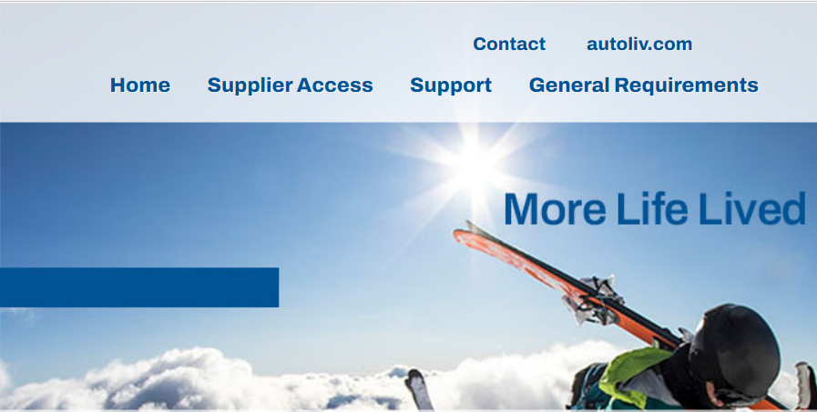
访问供应商行为准则
更新后的守则将于 2023 年 1 月 1 日在以下网址提供： www.Autoliv.biz
有关守则的问题，请联系您的对口采购联系人
该准则将以 18 种语言提供，包括英语
Commercial Terms and Conditions for Indirect Purchasing
Supplier Code of Conduct
Supplier Portal Privacy Policy and Data Privacy Notice for Business Partners
Information Security Requirements for Supplier
Site Usage Requirements
Notes:
English External
As of 1 January 2023, the revised Autoliv Code of Conduct with be available on www.Autoliv.biz using the partner portal. The Code will be available in 18 languages.
We highly suggest that you read through The Code with your management team to ensure alignment. Acceptance of the Autoliv Supplier Code of Conduct will be a hard requirement to transact business with us and must be cascaded to your sub-suppliers to implement as well.
We will continue updating other content on the partner portal as it becomes available. If you have questions, please reach out to your Autoliv contact/lead buyer

Slide 16
Script: Slide 8
ENGLISH External
As of 1 January 2023, the revised Autoliv Code of Conduct with be available on www.Autoliv.biz using the partner portal. The Code will be available in 18 languages. We highly suggest that you read through The Code with your management team to ensure alignment. Acceptance of the Autoliv Supplier Code of Conduct will be a hard requirement to transact business with us and must be cascaded to your sub-suppliers to implement as well. We will continue updating other content on the partner portal as it becomes available. If you have questions, please reach out to your Autoliv contact/lead buyer | 自 2023 年 1 月 1 日起，修订后的奥托立夫行为准则可通过合作伙伴门户网站 www.Autoliv.biz 获取。 该准则将以 18 种语言提供。 我们强烈建议您与您的管理团队通读本准则，以确保保持一致。 接受奥托立夫供应商行为准则将是与我们进行业务往来的硬性要求，并且必须传递到您的次级供应商以实施。 我们将继续更新合作伙伴门户上可用的其他内容。 如果您有任何疑问，请联系您的奥托立夫联系人/主要采购员

Slide 17

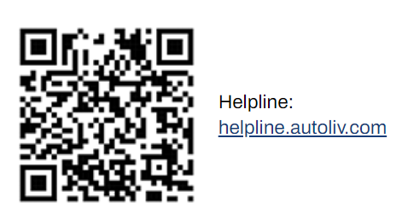
我们如何直言不讳@Autoliv
如果您不愿意亲自说出来，那么 Autoliv 帮助热线将全天候 24 小时开放，您可以秘密报告问题。
永远记住，如果您出于善意提出疑虑或说出潜在的不当行为，您在 Autoliv 的未来不会面临任何负面后果。
Notes:
English External
A safe working environment at Autoliv means much more than just our physical safety and health, it also means our mental wellbeing and our capacity to feel safe to speak up.
If we do not feel safe to speak up and know we will be listened to, then we risk not only our physical safety, but also our integrity, and ultimately the safety of our end users.
At Autoliv we have a broad definition of speaking up. For us speaking up covers all discussion that has the intention to support positive change or improvement. Therefore, speaking up covers raising a concern, but also asking a question, sharing knowledge, encouraging inclusion, or proposing a new way of doing things. These are all examples of speaking up.
If you encounter situations where this Code appears to have been violated, please, Speak Up!

Slide 18
Script: Slide 9
ENGLISH External | Chinese
A safe working environment at Autoliv means much more than just our physical safety and health, it also means our mental wellbeing and our capacity to feel safe to speak up. If we do not feel safe to speak up and know we will be listened to, then we risk not only our physical safety, but also our integrity, and ultimately the safety of our end users. At Autoliv we have a broad definition of speaking up. For us speaking up covers all discussion that has the intention to support positive change or improvement. Therefore, speaking up covers raising a concern, but also asking a question, sharing knowledge, encouraging inclusion, or proposing a new way of doing things. These are all examples of speaking up. If you encounter situations where this Code appears to have been violated, please, Speak Up! | 在奥托立夫，安全的工作环境不仅意味着我们的人身安全和健康，还意味着我们的心理健康和我们畅所欲言的能力。 如果我们说出来时不能感觉到安全，并且知道我们会被倾听，那么我们不仅会冒人身安全的风险，还会危及我们的诚信，并最终危及我们最终用户的安全。 在奥托立夫，我们对畅所欲言有一个广泛的定义。 对我们而言，畅所欲言涵盖所有旨在支持积极变革或改进的讨论。 因此，畅所欲言不仅包括提出疑虑，还包括提出问题、分享知识、鼓励包容或提出新的做事方式。 这些都是直言不讳的例子。 如果您遇到违反本准则的情况，请大声说出来！

